Slide 1
Uncovering a Disability: How to Have That Conversation with Parents
Guidelines for School Administrators to Consult when First Informing Parents of a Child’s Disability
Tara Rohall
University of Pittsburgh
© Copyright 2012 T. Rohall
Notes:
Slide 1: Uncovering a Disability: Many parents view their children as their shining stars. At times it can be extremely difficult for parents to hear that their star is “different”. The stigma associated with the word disability, disorder, and diagnosis can be viewed as negative and sadly, may imply imperfection or failure. A significant role of school leaders when facilitating meetings that share such information is to help redirect such beliefs. Rather than casting a negative, sad tone, consider placing this information in the context of “now we know how we can help”, or “this explains why we have misunderstood him all along.” So then, imagine facilitating a meeting and being present when a parent hears from the school psychologist that their son has autism, or their daughter has a specific learning disability, or that their adolescent is clinically depressed. The following is a resource that intends to help school leaders not only understand their role in such a meeting, but more importantly equip them with guidelines by which to ensure all school personnel attending are aware of what to do, and what not to do.

Slide 2
Take Away
Guidelines encompassing how to tell parents their child has a disability
What the meetings should include
How to manage your own emotions and anxieties throughout the situation
Notes:
Slide 2: Take Away: From the following presentation, school administrators will take away a general set of guidelines on how to deliver difficult news to parents. Hopefully administrators will be able to utilize these guidelines to better understand what is involved when sharing the news with parents for the first time that their child has a disability.

Slide 3
Discussed Disabilities
Post-traumatic Stress Disorder
Eating Disorders
Depression
Panic Disorder
Anxiety
Emotional Disturbance
Obsessive Compulsive Disorder
Intellectual Disability
Learning Disability
Aggression
Speech Impairment
Bipolar Disorder
Substance Abuse
Attention Deficit Hyperactivity Disorder
Notes:
Slide 3: Discussed Disabilities: In k through 12 school settings, children who struggle academically over a period of time are evaluated by the school psychologist to determine how to better help the child learn. While it is not the role of the principal to have a clinical understanding of every possible disability, it is helpful to know which resources are credible and accountable so that you can learn more about a particular disability. This slide represents a few disorders that are uncovered through evaluations.

Slide 4
Case Study
Notes:
Slide 4: Case Study. At Brighton Middle School, the principal, teachers, and other school staff noticed a definite change in Owen’s behavior over the past few months and in recent weeks his depressive attitude and actions were becoming more prevalent. One of Owen’s teachers met with Owen’s parents who confirmed the same struggles at home. With the parent’s permission, the school psychologist evaluated Owen using a variety of measurements. The outcome of the data collected was that Owen was depressed due to several traumatic events. The principal knew the next step needed to be telling Owen’s parents about the disorder. Therefore, the school principal asked Mr. Davidson (Owen’s father) to meet him in Owen’s classroom for a meeting the next morning.
School Principal: “Thank you for coming in today, Mr. Davidson. We have some very important information to talk about concerning your son, Owen. (Kids, please quiet down. I am trying to have a conversation with Mr. Davidson.) As you previously learned from Owen’s teacher, he’s been having trouble academically and personally. His grades are suffering, his class participation is lacking, and he’s been either not attending or otherwise very disengaged during his after school activities. His social skills have taken a turn as his teachers have noticed him pulling away from friends he was close to and sitting alone at lunch. Basically, to get to the point, your son has depression.
Mr. Davidson: “What? That can’t be right at all. Owen just had out the board game monopoly with the babysitter last night. How can he be depressed? Depression occurs in adults and it’s when people commit suicide! That can’t be affecting Owen. I need to leave and go speak with my wife.”

Slide 5
“Good disclosure practice prevents much distress for parents, and can form the beginning of positive parent-professional relationships, facilitates the attachment process, and when combined with family support services over the first years, reduces levels of anxiety and stress.”5
Notes:
Slide 5: Quote: There are many examples within this situation that illustrate how NOT to conduct a meeting that discloses such sensitive information. This could have been handled differently in order to encourage positive outcomes such as sustaining relationships and talking about solutions and ideas. Much research has been done in which discussions between school administrators and parents were examined and data was collected and then analyzed. The results from this research have led to many strategies addressing how to inform parents of their child’s disability. Making these strategies available to staff will increase their levels of comfort, preparedness, and confidence as they learn how to implement ideas and practices conducive to a positive outcome.

Slide 6
Formal Plan
Preparation
Delivery
Be aware of possible reactions and responses
Follow-up
Notes:
Slide 6: Formal Plan: As mentioned previously, it will be extremely helpful for your school to create and implement a formal process that can be followed when having this discussion with parents is necessary. The plan may be simple and include general steps or it may be more detailed depending on what school leaders feel best suits their school and students’ needs. This plan can be used to guide your interactions with parents and will be a good place for school leaders to start in order to make sure all the bases are covered before beginning any discussions with parents.

Slide 7
Where Parent Dissatisfaction Can Stem From⁴
Behaviors of other adults⁴
Distracted
Uncaring
Confused
Information⁴
Not enough
No recommended resources
Denied accurate information
Organization⁴
Lack of privacy
Lack of direction
Availability of staff
Notes:
Slide 7: Where Parent Dissatisfaction Can Stem From: In order to have an effective plan one must first understand the nature of the problem. Studies starting in the 1950s up to today have shown that between 40%-80% of the parents interviewed were all dissatisfied with the same three things concerning the way they were told about their child’s disability (4). First, is the manner in which the school leader behaved while telling the parents of their child’s disability. Parents were unhappy if the school leader was unsympathetic or seemed distracted. The second point of dissatisfaction was the way in which information was communicated to parents. This included a lack of information, inaccurate information, or being denied information. The third area was the aspect of the school’s organization. This includes lack of privacy during the meeting, no help finding outside services for their child, and difficulty getting help after the meeting. It is possible to avoid all three of these dissatisfactions with careful preparation.

Slide 8
Preparation⁶
Determine who should attend the meeting
Both parents or a relative or trusted friend
Certain school leaders
No child
Ask parents to meet face-to-face at the school
Notes:
Slide 8: Preparation: The first stage of the preparation involves determining who will attend the meeting. Both parents or guardians should be invited. If one cannot make it or there is a single parent, another relative or trusted adult should be invited in order to provide support. Learning difficult news alone can be onerous. When deciding which school professionals should be in attendance ask the question “who will bring unique information or perspectives that would be helpful?” For example, an interpreter should be invited to the meeting if both parents are not fluent in English. Consider, though, that too many school personnel in the meeting can be intimidating to parents. Also, be sure to communicate ahead of time who will will deliver the difficult news. The role of the school psychologist to do so as this professional is qualified and trained to interpret the measurements and to explain the disability. . It is typically the role of the school leader to perhaps facilitate such a meeting, to be attentive, supportive and learn themselves about how they can better support the student’s learning. It is much easier on parents if the actual diagnosis comes from only one person.
Also, research has shown that a very high percentage of parents would rather not have their child in the room during the discussion(6). It is a lot of information to take in and many times the parents need time to deal with their emotions and understanding of the disability before facing the child. The second prep step is actually inviting the parents to the meeting. This should be done as soon as the disability is diagnosed or suspected. It is best to tell a child’s parents in person about the disability. Therefore, when inviting them to the school use general information and only disclose information over the phone about the disability if the parent asks directly for more information.

Slide 9
Preparation (continued)
Choose an appropriate setting
Become knowledgeable about the child’s specific disability
Notes:
Slide 9: Preparation (continued): Continuing to prepare for the meeting, the third step is choosing an appropriate setting for the meeting to take place. Make sure the room is comfortable, private, and reserved in advance for a sufficient amount of time. Also, have the seating arrangement pre-planned so it does not end up with parents seated on one side of the room and school leaders on the other side. In addition, take time to look into the details of the room to make sure there are paper and pens and tissues readily available. After the room is reserved the fourth step is to take some time and learn about the child’s specific disability. This will allow you to ask appropriate questions when generating ideas to support specialized instruction and learning for the student. This encourages trust between the parent and the school leader. It also demonstrates that the school leader cares, is interested, and invested in helping the child.

Slide 10
Pre-delivery²
Parent-friendly framework²
Empathize with parental concerns
Relate positively to the child
Let parents know they are already addressing child’s needs
Same story should be supported by all school administration
Notes:
Slide 10: Pre-delivery: Many professionals who have experience delivering such sensitive information in schools, hospitals, and clinical settings have found one of the best strategies to keep in mind is parent-friendly framework (2). This means that when sharing this information the deliverer should empathize with parent ‘s concerns, relate positively to the child, and encourage parents that just by being here they have already taken a major step in helping and supporting their child. Also, make sure that all school personnel are on the same page to keep from confusing parents. Then directly after the news has been delivered keep in mind the parent-friendly framework and how hopefulness is a part of that. From this you can focus on the parent’s coping method and support the child’s development to provide plans for the future.

Slide 11
Delivery¹
Introductions
Mention what the child has been doing well
Give examples that validate the child’s disability
“Warning shot”
Inform parents of the child’s disability
Notes:
Slide 11: Delivery: Once all attendees are gathered in the room, the meeting should begin with introductions and a brief summary of why the referral for evaluation was made and that the purpose of the meeting is to discuss the results of the evaluation. Start off on a positive note by sharing positive points and characteristics about the child. Then begin to give examples of the child’s behavior that display his or her disability. These examples will prepare parents for news of the disability. Parents may even be able to connect with this information if they have noticed the child displaying those behaviors at home. However, some parents still may not see the direction in which the discussion is headed through these examples so it is best to present a “warning shot.” (1) A “warning shot” is a statement alerting parents that the following information will be new to them and may be disturbing. Then the next and most important step is to directly inform the parents of their child’s disability. Be sensitive and caring but do not beat around the topic or use euphemisms to try and soften the information. Parents want accurate and honest information.

Slide 12
Delivery (continued)
Attempt to acquire the parent’s level of understanding, feelings toward, and acceptance of their child’s disability
Remember to give parents a chance to speak
Provide further information about the disability in order to familiarize parents with what their child is going through
Provide handouts of recommendations and resources
Notes:
Slide 12: Delivery (continued): After delivering news of the disability try to obtain the parent’s level of understanding, feelings toward, and acceptance of it. This is where the meeting becomes very individualized because depending on the parent’s knowledge and acceptance the newly learned information, the facilitator must decide which step to take next or if any of the previous steps should be repeated. After this is decided school psychologist should provide further information to parents about the disability so they can grasp a general idea of what their child is dealing with. Parents want to know the prognosis, possible treatment, care, and the future expectations. Along with this verbal explanation it is also a good idea to provide written information for parents to take home with them. It is difficult for most parents to take in all of this information at once so being able to take it home to review can be a great help.

Slide 13
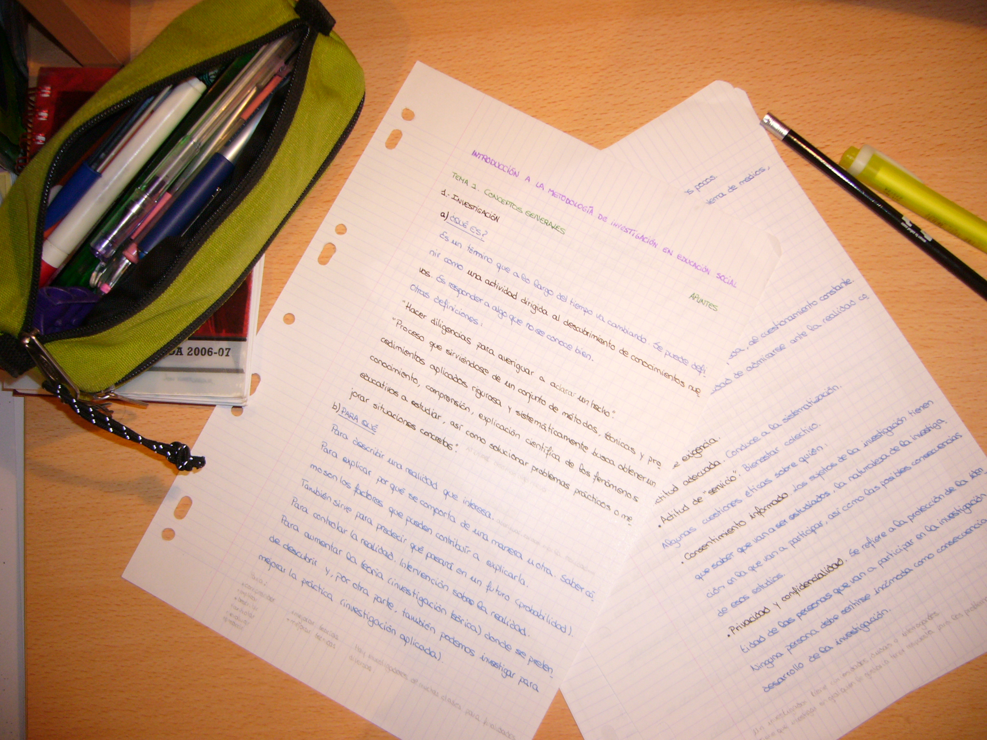
What to Include in Handouts
Information about the specific disability
Recommendations for parent coping
List of community resources
Information to connect the parents with other families who are in similar situations
Notes:
Slide 13: What to Include in Handouts: This is a list of items that should be considered when putting together packets of information for families to take home with them. Remember to have one packet for each person. While you as the school leader may not be responsible for assembling such information, you can certainly encourage your pupil services or special education department to have these materials prepared for such meetings.

Slide 14
Delivery (continued)
Encourage parents to ask questions
Point out the child’s strengths
Notes:
Slide 14: Delivery (continued): After sharing news of the disability as the meeting is nearing it’s close remember to encourage parents to ask questions. Some may be curious and ready to ask a lot of questions while others may not be ready to talk about their child or the disability yet. However, it is always good to make the effort so parents know the school leaders are available and willing to help. School leaders should also point out the child’s strengths and restate great things the child has done lately in order to end the meeting on a more positive note and encourage participation in future planning. Try and take the extra step and remind the parents that they have an amazing child, who is still a shining star.

Slide 15
Possible Parental Reactions
Possible reactions from parents after learning of the disability
Relief
Physical responses such as crying, thirst, or heavy breathing
Anger or agitation
Disbelief
Shock
Distress
Helplessness
Notes:
Slide 15: Possible Parental Reactions: Just like a magician must always be prepared with a backup plan incase his magic trick goes awry and the audience questions him or throws tomatoes, school leaders should be prepared to experience many different reactions from parents after hearing potentially difficult news. It is best to be knowledgeable and prepared for the ways in which parents may react so that you, as the school leader, do not become flustered and add to the parents uneasiness. Think about the variety of possible outcomes and be ready to deal with any of them. One of the best ways to handle parental reactions is to listen and allow the parents to vent their feelings. Also, be sure not to offer premature reassurance such as by saying, “I’m sure this is not as bad as you think- just remain positive.” Instead, be honest and acknowledge that this must be difficult and distressing experience for them.

Slide 16
Possible School Leader Reactions
Possible reactions of school leaders when presenting difficult news
Physical symptoms such as stuttering or rising heart rate
Nervousness
Questioning one’s own abilities
Fear of litigation
Feel blame for being the messenger
Notes:
Slide 16: Possible School Leader Reactions: This situation should not be taken lightly as it can be daunting to facilitate a meeting sharing such information with parents. Be aware of the possibility that you may react strongly in different ways than you might have expected. However, thinking through your possible responses may decease your surprise at your own reactions and increase your ability to manage them. Parents will be surprised enough for all parties so it is extremely helpful if school leaders remember to focus on the emotions of the parents rather than their own emotions during the meeting. School leaders should anticipate experiencing unexpected feelings and be prepared to manage these emotions in order to decrease the potentially negative impact on the meeting.

Slide 17
Follow-up¹
Phone call approximately 24 hours after the meeting
Schedule a follow-up meeting in about a weeks time if parents would like
Allow parents to invite their child to the meeting
At the follow-up meeting
Allow them to ask additional questions
Provide them with more or updated information
Assist them further in finding support groups or other helpful resources
Notes:
Slide 17: Follow-up: Follow-up is very important because it shows parents that the school leader genuinely cares about their child. Begin with a phone call approximately 24 hours after the meeting to make sure the parents are holding up and to schedule another meeting if they would like to come back to the school. If someone else in your building schedules these meetings, be sure you are made aware of when the meeting is so that you may attend if possible. This meeting will determine the coping skills of the parents and allows the school to provide additional help and references such as special education or community based services. Sometimes, the parents may want their child to be involved in this follow-up meeting to help him understand his disability and learn more about it with his major support group there.

Slide 18
Case Study (revisited)
Notes:
Slide 18: Case Study, revisited: Back at Brighton Middle School, the principal, teachers, and other school staff noticed a definite change in Owen’s behavior over the past few months and in recent weeks his depressive attitude and actions were becoming more prevalent. One of Owen’s teachers met with Owen’s parents who confirmed the same struggles at home. With the parent’s permission, the school psychologist evaluated Owen using a variety of measurements. The outcome of the data collected was that Owen was depressed due to several traumatic events. The principal knew the next step needed to be telling Owen’s parents about the disorder. In a private conference room are Owen’s mother and father, the school principal, the school psychologist, and one of Owen’s teachers. The team has communicated in advance that the principal will facilitate the meeting, but that the school psychologist will review the evaluation and share the formal diagnosis or disability.
School Principal: “Thank you for coming in today, Mr. Davidson. We have some very important information to talk about concerning your son, Owen. We are so happy to have Owen in our school – he is exceptionally bright, can be helpful and we notice he really enjoys art class. As you know, he was referred to our school psychologist for an evaluation because he’s been having trouble academically and personally. His grades are suffering, his class participation is lacking, and he’s been either not attending or otherwise very disengaged during his after school activities. His social skills have taken a turn as his teachers have noticed him pulling away from friends he is normally close to and sitting alone at lunch. Our school psychologist, Dr. Marr, would like to review the results of Owen’s evaluation with us.
Dr. Marr: These results from Owen’s evaluation may not be exactly what you are ready to hear. However, this news will explain where some of the behaviors Owen has been demonstrating are stemming from. After taking an extensive report is it clear that your son Owen can be diagnosed with depression. Depression is a common mental illness that affects how someone thinks, feels, or behaves. It causes sadness and loss of interest and may lead to further emotional and physical problems. However, depression can be countered with counseling, medication, and other treatment. We are all here today to support Owen and your entire family in taking the steps necessary to help Owen.
Mr. Davidson: This is pretty difficult news to hear. Owen just had out the board game monopoly with the babysitter last night. I thought depression only occurred in adults.
Mrs. Davidson: I can’t believe it either. But I guess I just brushed off Owen’s grumpiness lately as crazy hormones. I shouldn’t have done that. So where do we go from here?
School Principal: We certainly understand that this is a great deal of information to take in right now. We would like to give you some time to talk this news over with each other and possibly with Owen. We would be glad to meet with all three of you to explain anything further within the coming week if you are available. We have compiled a short list of materials that will help explain what depression is, what Owen is currently going through, and ways in which you can provide support. Please call any of us here is you have any questions after you leave and I call you soon about possibly planning a follow-up meeting to see how everything is going both at school and at home.

Slide 19
What Went Right
Principal was prepared
Setting was appropriate
Dialogue was open and comfortable
Began with positive comments
Both parents present
“Warning shot” was implemented
Notes:
Slide 19: What Went Right: This meeting had a positive outcome and has laid the foundation for future work because the school leadership was prepared. They had a private meeting room set up so there were no distractions like the kids in the previous case study. They made sure to invite all of the necessary personnel, which included not only the school principal, but also a teacher and school psychologist in order to provide the correct information and support. Also, both of Owen’s parents were invited to the meeting so it allowed for them to have their partner’s support while hearing the news. In turn this support provided for a relaxed atmosphere where Owen’s parents felt comfortable enough to ask questions. What also added to this was the positive dialogue at the start and a “warning shot” just before learning of the diagnosis. All of these techniques and strategies can be implemented into a formal process so that school leaders will be as prepared as Owen’s school leaders in this case study.

Slide 20
“The process of sharing bad news is a complex linguistic and psychological process in which realism, pessimism, hope, and optimism are all negotiated in an atmosphere of shared tension and anxiety.” 1
Notes:
Slide 20: Quote: When school leaders create a formal process at their school, they should remember that telling parents about a child’s disability is definitely not an easy task but certainly one worth preparing for in order to increase positive climate and chances of future collaboration. Thank you for listening to my presentation and good luck in all of your future meetings!

Slide 21
References
Auger, R.W. (2006). Delivering difficult news to parents: Guidelines for school counselors. Professional School Counseling, 10, 139-145. Retrieved from: http://proquest­.umi­.com/pqdlink­?did=1186932461­&Fmt=2­&clientId=17454­&RQT=309­&VName=PQD
Bartolo, P.A. (2002). Communicating a diagnosis of developmental disability to parents: Multiprofessional negotiation frameworks. Child: Health, Care, and Development, 28, 65-71. doi: 10.1046/j.1365-2214.2002.00243.x

Slide 22
References
Boyd, J.R. (2001). A process for delivering bad news: Supporting families when a child is diagnosed. Journal of Neuroscience Nursing, 33, 14-20. Retrieved from: http://go.galegroup.com/ps/i.do?id=GALE%7CA73889745&v=2.1&u=upitt_main&it=r&p=AONE&sw=w
Harnett, A., Tierney, E., & Guerin, S. (2009). Convention of hope–communicating positive, realistic messages to families at the time of a child’s diagnosis with disabilities. British Journal of Learning Disabilities, 37, 257-264. doi: 10.1111/j.1468-3156.2009.00580.x

Slide 23
References
Nissenbaum, M.S., Tollefson N., Reese M.R. (2002). The interpretative conference: Sharing a diagnosis of autism with families. Focus on Autism and Other Developmental Disabilities, 17, 30-43. doi: 10.1177/108835760201700103

